Slide 1

The State of EMS in Grafton County, NH
Presentation to the Grafton County Commissioners
February 17, 2026

Slide 2


Process
Stakeholder survey
Site visits
EMS resources review
Data analysis
Demographics & growth
In-person interviews
Phone and virtual interviews
SCOT analysis
Mapping tool

Slide 3
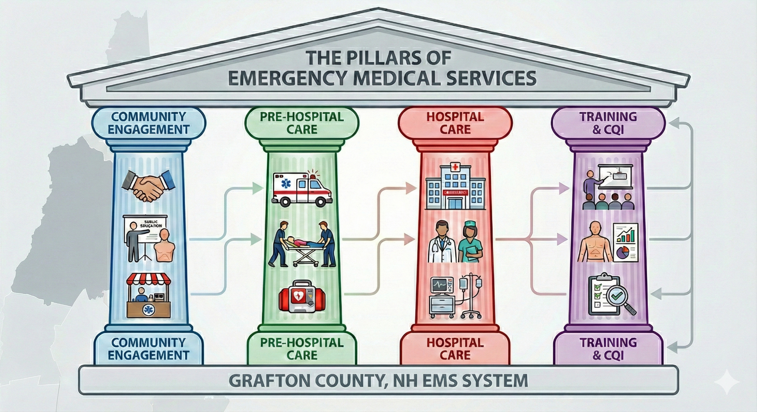
Pillars of the Grafton County EMS System

Slide 4

Financial Support & Oversight
Volunteers
Public Education

Slide 5

Communications & Dispatch
First Responders
Basic & Advanced Life Support
Ambulance Transport
Medical Direction & Protocols
Mobile Integrated Health (MIH)

Slide 6

Critical Access Hospitals
Stroke Centers
Trauma Centers
Interfacility Transfers (air & ground)

Slide 7

Recruitment & Retention
Training
Certification & Licensing
Continuous Quality Improvement

Slide 8

Current State of EMS
System Overview
Rising Demand
Service Gaps
Workforce Crisis
Notes:
System Overview: The county is served by 19 ambulance transport services (14 fire-based, 3 municipal, 2 non-profit) and 8 non-transport FAST squads.
Rising Demand: EMS call volume increased by 20.1% over the last five years (2019–2024), while the population only grew by 3.5%.
Service Gaps: 10 out of 14 surveyed services report difficulty meeting call volume demands due to limited personnel and reliance on mutual aid.
Workforce Crisis: The system relies heavily on a "graying" roster of providers aged 50–60+, with a severe shortage of younger recruits and volunteers.

Slide 9

Critical Challenges & Threats
Financial Instability
Equipment Costs
Housing Barrier
Recruitment/Retention
Interfacility Transfer Bottleneck
Notes:
Financial Instability: The cost of 24/7 ALS readiness is ~$1 million annually, yet Medicare/Medicaid reimbursements do not cover the true cost of service.
Equipment Costs: The price of a new ambulance has risen 30–50% since 2020 (now $250k–$500k+) with delivery wait times of two years or more.
Housing Barrier: Potential recruits cannot afford to live in the towns they serve, directly impacting staffing levels.
Recruitment/Retention: Volunteer availability is limited; experienced full-time and per diem providers are in a competitive market.
Interfacility Transfer Bottleneck: Hospitals struggle to find ambulances for critical transfers because 911 agencies must prioritize their primary response areas.

Slide 10

Opportunities for Improvement
Regionalization
Funding Shifts
Rural Health Transformation (RHT)
Telemedicine
Notes:
Regionalization: Shift from a town-by-town model to a "hub and spoke" system where larger agencies (e.g., Plymouth, Littleton) formally cover smaller communities.
Funding Shifts: New state legislation (SB 245) temporarily sets private insurer reimbursement at 350% of Medicare rates, providing some financial relief.
Rural Health Transformation (RHT): NH is eligible for ~$500 million in federal funds (2026–2030) which can support regional mobile integrated health (MIH) and telemedicine projects.
Telemedicine: Expanding "Treatment in Place" (TIP) capabilities to reduce unnecessary transports and generate new revenue streams.

Slide 11

Mapping Tool
Jason Blair, CAI Technologies

Slide 12

Key Recommendations for Commissioners
Establish a Strategic Task Group
Volunteer Recruitment & Retention Program
Advocate for Data & Funding
Funding Initiatives to Support Communities
Notes:
Establish a Strategic Task Group: Create a formal body to coordinate planning, identify synergies, and seek funding without superseding existing mutual aid systems.
Volunteer Recruitment Program: Launch a county-wide initiative to recruit volunteers, modeled after national best practices, including a coordinator and marketing materials.
Advocate for Data & Funding: Push for sustainable reimbursement rates and demand better data availability from the State Bureau of EMS.
Funding Initiatives:
Establish a fund for FAST teams to acquire AEDs and trauma kits.
Pursue group purchasing for vehicles and equipment to lower costs.
Aggressively pursue Rural Health Transformation grants for innovative regional projects.

Slide 13

Conclusion & The Path Forward
Status Quo is Unsustainable
No “One-Size-Fits-All” Solution
Call to Action
Notes:
Status Quo is Unsustainable: The current fragmented system cannot survive the fiscal and resource pressures it faces.
No "One-Size-Fits-All" Solution: A single county-run EMS service is likely not feasible; the path forward requires building on existing strengths and fostering partnerships.
Call to Action: The sustainability of the system depends on a collective willingness to adapt, consolidate resources, and embrace new models of care.

Slide 14

Thank You
Website:
www.mrigov.com

